Slide 1
COVID-19
PLAN FOR THE RETURN TO WORK
Toolbox Talk

Slide 2

INTRODUCTION
CRISIS MANAGEMENT→ Phase development
Incident
PHASE 1:
EMERGENCY
RESPONSE
PHASE 2:
INCIDENT
MANAGEMENT
PHASE 3:
ACTIVITY
RECOVERY

Slide 3
About Coronavirus SARS-CoV-2 and COVID-19
Basic Characteristics
Virus → not a living form→ needs a host (foreign biological material) to multiply
Low bio-hazard
Highly contagious
Retro virus
    Vulnerable
    Easily mutated (200 mutation already identified)
Not transmitted trans-dermally
Apart from the respiratory system, it contaminates other vital organs such as the liver, heart, kidneys and the brain.

Slide 4
About Coronavirus SARS-CoV-2 and COVID-19
Basic Characteristics
We know very little about its biological behavior
It is not seasonal
There is no currently medication commercially available
There is no vaccine; the approval process is time consuming (1-2 years)
It is airborne; it is transmitted by droplets or its dehydrated cores.

Slide 5
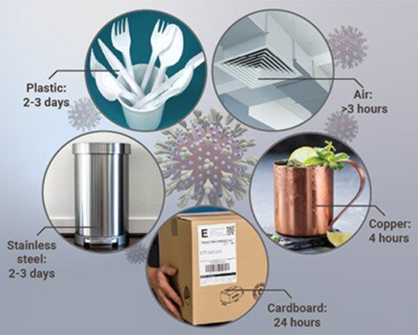
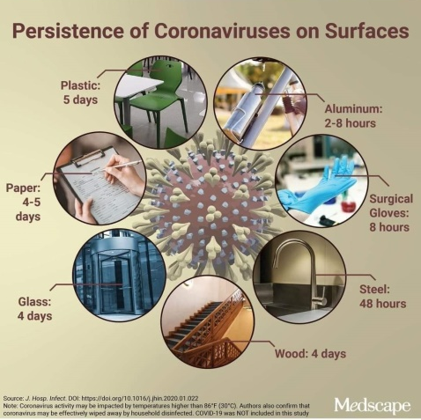
CORONAVIRUS SARS-CoV-2
BASIC CHARACTERISTICS
It has relative durability on the various surfaces; however, further studies have shown that surface contamination is rare.
In order to be contaminated after touching a surface 3 preconditions must hold simultaneously:
The surface must have been recently contaminated
One must touch the same surface area shortly after
After touching the surface they must touch their face shortly after

Slide 6

CORONAVIRUS SARS-CoV-2

Slide 7
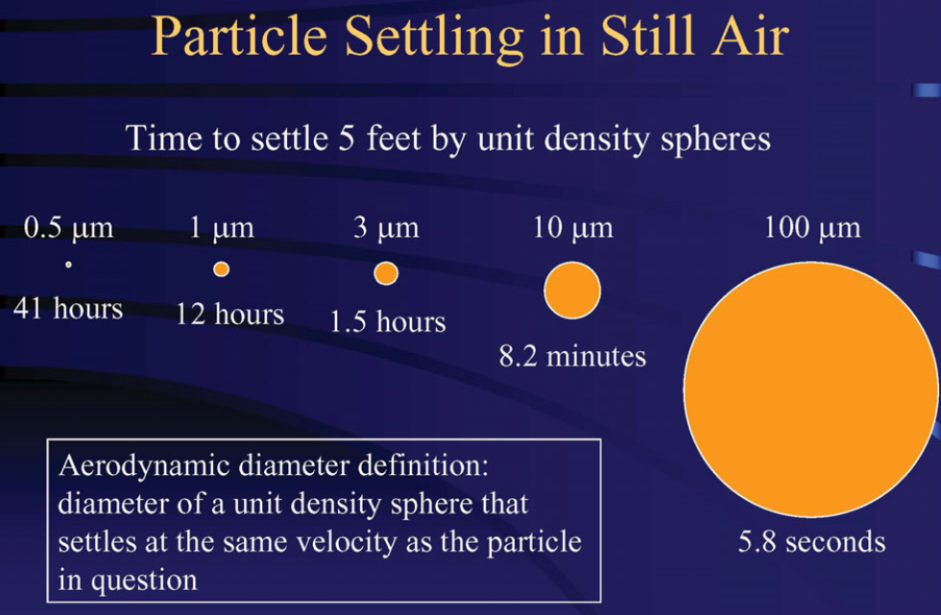
DROPLETS CHARACTERISTICS
SARS-CoV-2 nucleus diameter
0,060-0,140 μm

Slide 8
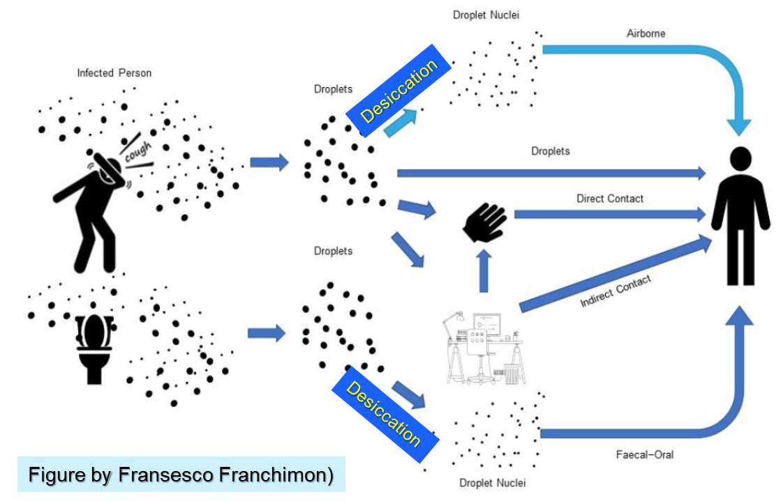
TRANSMISSION PATHS OF SARS-CoV-2
Transmission Paths of SARS-CoV-2

Slide 9
BASIC MEASURES IN A WORKING ENVIRONMENT
THE ROLE OF THE SAFETY CONSULTANT, THE OCCUPATIONAL DOCTOR & THE H&S COMMITTEE
All contracts remain active
All companies must update the Risk Assessment by entering the COVID-19 parameter
Due to insufficient data, the legal framework cannot provide documented responsibilities to employers because insufficient and specific instructions have not been given.
In any case, the role of the Occupational Doctor and the treating physicians must be used both symptomatically and in an advisory manner.
Source: ILO How do OSH professionals impact public-policy?

Slide 10
SELF-PROTECTION AND PREVENTION AGAINST DISEASE TRANSMISSION
Hand washing for at least 20sec
Distance from other people
at least 1.5-2 m
No face touching
When sneezing or coughing
we other use the inner part of
our elbow or a tissue
In case of suspicious symptoms
(cough, fever) we seek medical advice
We conform to the
Authorities’ rules

Slide 11
RISK ASSESSEMENT
EFFECTIVENESS
Elimination
Removal
Replacement
Isolation
Isolation of exposed workers
Training
PPE
HIGH
LOW

Slide 12
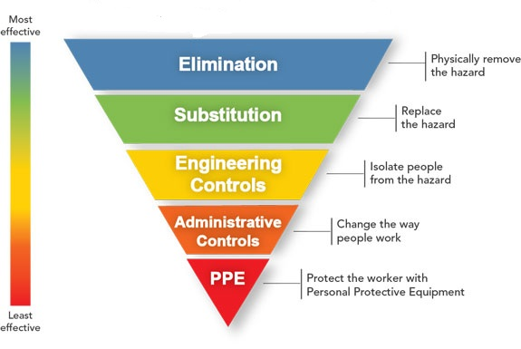
Hierarchy of measures

Slide 13
BASIC MEASURES IN THE WORKPLACE
CLEANING with hypochlorite solution 5-10%
HEALTH HYGIENE
Hand Washing→ posting instructions to all sinks and the exit door
Gels → one bottle in every room
DISINFECTION→ chemicals, frequency, certification
  By spraying
  By heating
  With local units
  With UVI lamps (local)
CLEANING MATERIALS → Safety Data Sheets, Risk Assessment and Safety Instructions.

Slide 14
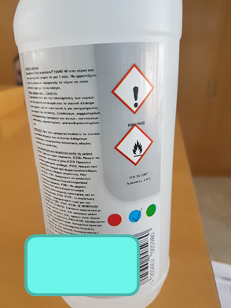
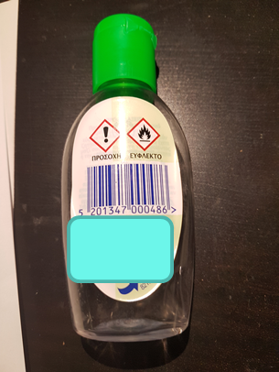
BASIC MEASURES IN ENTERPRISES
REASONABLE USE OF GELS
DO NOT OVERDO IT!!!
These chemicals are irritating and can cause allergies if used excessively
They do not need to be used when there is running water and soap
Keep gels for guests and for cases where you cannot wash your hands
At home it is NOT NECESSARY to use them, so just one 500ml bottle is enough

Slide 15

BASIC MEASURES IN ENTERPRISES
ORGANIZATIONAL MEASURES
Remote work
Work in shifts
Arrival/ departure at different times
Training (1 hour + repetition when needed)
Social distancing
Monitoring vulnerable people
Keeping a contact diary and tracking

Slide 16
ORGANIZATIONAL MEASURES
Α
B
MAINTENANCE
MAINTENANCE
C
D
MAINTENANCE
MAINTENANCE
…
Z
MAINTENANCE
MAINTENANCE

Slide 17
ORGANIZATIONAL MEASURES
01
02
Avoid using the elevator;
designate and post the maximum number of users;
masks should be mandated
The toilet lobby should only
be used by one person per space
03
04
Disable air dryers in the WC
Use only disposable paper hand towels

Slide 18
ORGANIZATIONAL MEASURES
05
06
Designate and post the maximum
number of people in the public and dining areas
Designate and post the maximum
number of participants in the meeting rooms
07
08
Use personal or disposable
utensils in the dining areas
Prohibit ordering of food & drinks

Slide 19
ORGANIZATIONAL MEASURES
09
10
Designate office space
for exclusive use
Designate furniture for exclusive
use including the seats
11
12
Prohibit close
person-to-person contact
Do not share items, even stationery
13
14
Prohibit recycling
within the premises
Install partitions (optional)

Slide 20
ORGANIZATIONAL MEASURES
15
16
Apply contactless delivery-receipt
of products
There should be enough time between delivery and mail distribution
17
18
Immediately dispose of packaging
Trash cans with lid with double trash or high endurance bag and pedal.
19
20
Designate a Suspected Case Isolation Room
Write an Incident Management Guide in collaboration with an
Occupational Physician

Slide 21
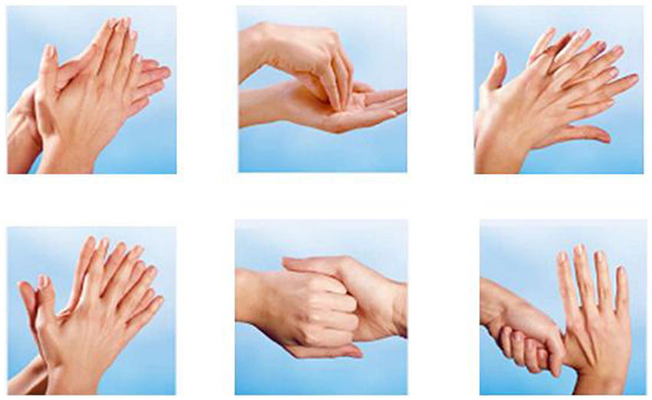
SIGNAGE

Slide 22
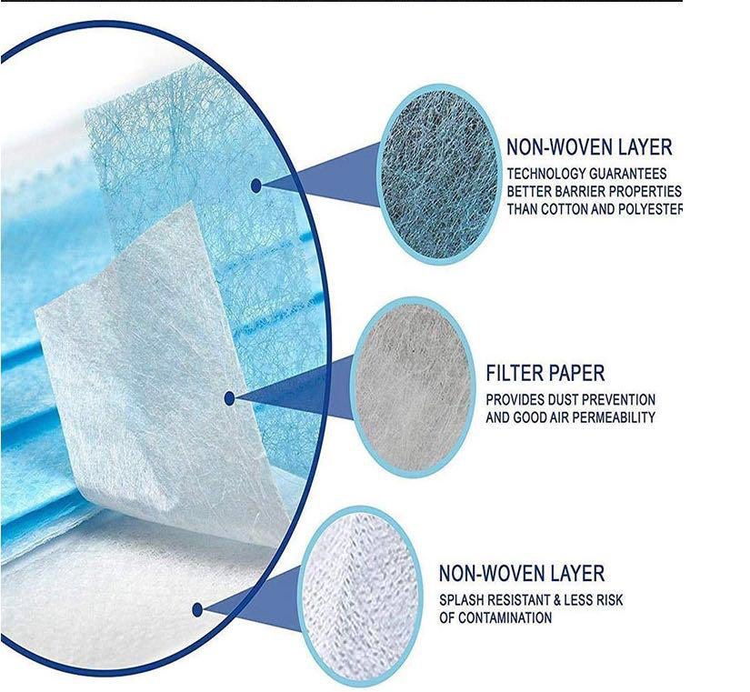
PERSONAL PROTECTIVE EQUIPMENT
SINGLE USE 3-PLY MASKS SHOULD BE USED (unless stricter requirements apply)
  When we have symptoms
  When we are taking care of vulnerable persons
  When we are in congested areas
  When we can't get rid of the habit of touching our face (from 25-60 times/ hour)
  When we are going to queue/ stand in line
  In any high-risk environment.

Slide 23
BASIC MEASURES IN ENTERPRISES
Mechanism of droplets entering the body
Source: Why we should all wear masks – Sui Huang Institute of Systems Biology

Slide 24
BASIC MEASURES IN ENTERPRISES
Different types of mask protection
Source: Why we should all wear masks – Sui Huang Institute of Systems Biology

Slide 25
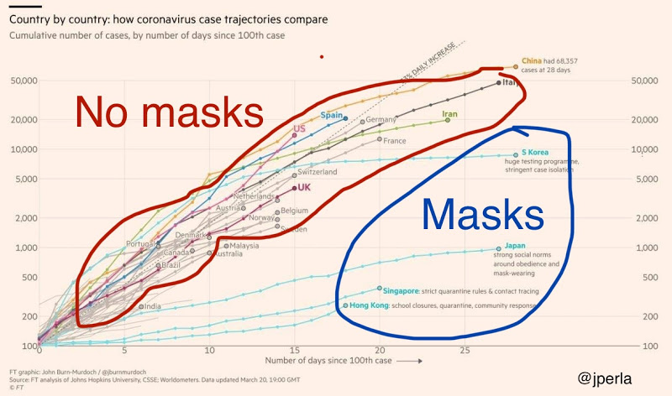
BASIC MEASURES IN ENTERPRISES
Courses of COVID-19 infections in states where citizens wear (blue) and do not wear (red) mask

Slide 26
BASIC MEASURES IN ENTERPRISES
MANAGERIAL MEASURES (Pandemic Phase)
Prepare an Social Media Information Management Team → manage fake news
Remote work does not mean isolation → Keep constant communication with workers
  Ensure a reliable flow of information about the situation
  Stay informed about their health condition
  Stay informed about their psychological condition
  Manage their insecurities
The same, of course, applies also for the self-employed.

Slide 27
BASIC MEASURES IN ENTERPRISES
MANAGERIAL MEASURES (Return to work Phase)
Managing employee insecurity: are they or are they not the Company's most valuable asset?
Manage the employees behavior after the loosening of the measures.
Panic attack management in case of future symptoms
Keeping tracking of contacts
Ensuring reliable information after their return on a permanent basis until the final solution of the problem
Preparation for any global or local recurrence based on an Management Action Plan (eg evaluation of measures taken) → identify errors → improvement actions (which should be funded).

Slide 28
BASIC MEASURES IN ENTERPRISES
MANAGERIAL MEASURES AT PHASE C’ (BUSINESS CONTINUITY)
The return will be as gradual as the entry into the crisis unless there is a medical discovery-miracle; at a time span of 3 months after comeback everything will have been forgotten, hence within in this period:
  Evaluate the total plan applied
  If you are satisfied with everything then you are wrong because you haven’t learnt anything!
  Develop a Crisis Management Plan and not just a Business Continuity Plan.

Slide 29
AIR CONDITIONING (recommendations)
01
02
Ventilation systems will operate
24/7 at low speed
Natural ventilation is preferable or can
be used in combination with the air conditioning
03
04
Recirculation systems must be
switched off
The local cooling-heating units will either be deactivated or used in combination with natural ventilation or will operate 24/7
05
06
FCU systems will operate 24/7
Air conditioning systems (e.g. AHU) should be converted to allow the maximum fresh air intake

Slide 30
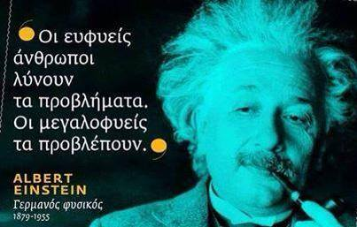
UPDATE THE VALUE OF LEADERSHIP AGAINST SMALL MANAGEMENT
Brilliant people solve problems; ingenious people predict them.

